Slide 1
Conditional Statements

Slide 2
Agenda
Conditional statements:
If statement
If-else statement
If elif else statement
Nested if-else
Loops
For Loop
While Loop
List Comprehension

Slide 3
Let’s explore conditional statements
Conditional statements are handled by ‘if’ statements in python
Conditional statement perform computations or actions depending on the boolean constraint is evaluated as true or false
If the constraint is ‘True’, the statements in the body are executed, and if it is ‘False’, the statements in body are skipped
Conditional statements:
If statement
If-else statement
If elif else statement
Nested if-else

Slide 4
If Statement

Slide 5

If statement
The syntax of the if-statement is:
Python logical conditions supported are
Equivalence `==`
Inequivalence `!=`
Less than `<`
Greater than `>`
Less than or equal to `<=`
Greater than or equal to `>=`
If statement can be nested

Slide 6
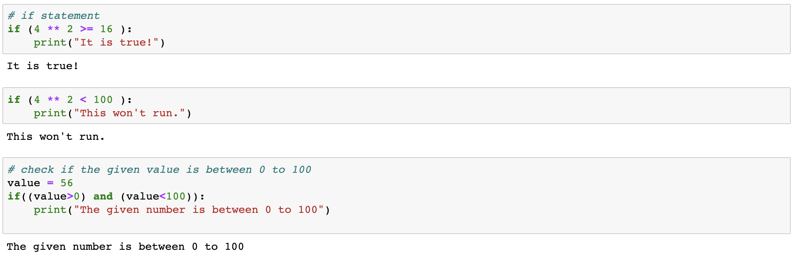
If statement

Slide 7
The if...else Statement

Slide 8
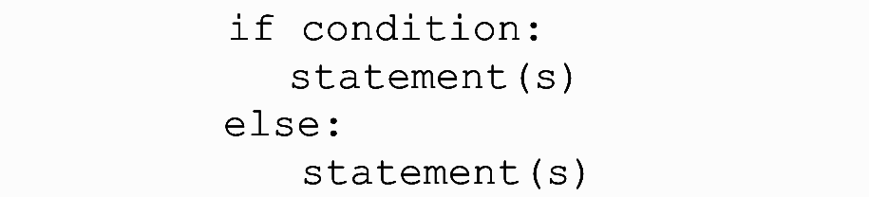
If-else statement
The syntax of the if-statement is:
The statement(s) under ‘else:’ are executed when the condition in ‘if ’ is not satisfies, ie., the boolean output is ‘False’

Slide 9
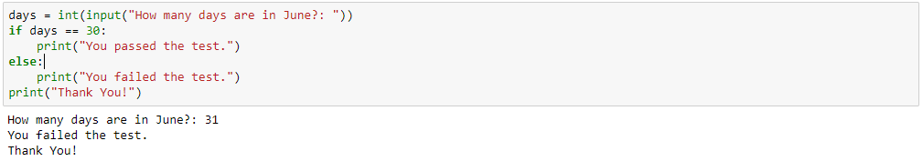
If-else statement

Slide 10
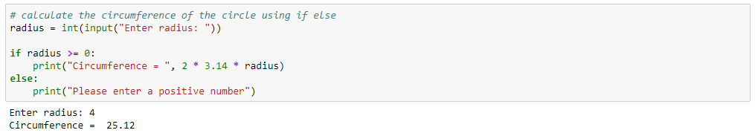
If-else statement

Slide 11
If elif else Statement

Slide 12

If elif else statement
Elif statement is used to control multiple conditions only if the given if condition false
It's similar to an if-else statement and the only exception is that in else we are not checking the condition but in elif, we check the condition
The syntax of the if elif else is

Slide 13
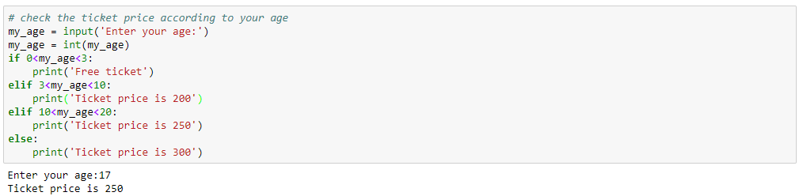
If elif else statement

Slide 14
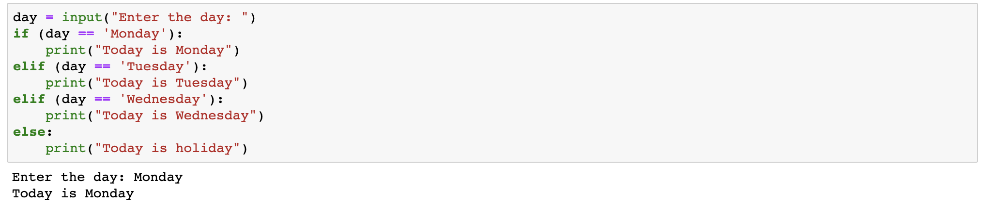
If elif else statement

Slide 15
Nested if and if...else Statement

Slide 16
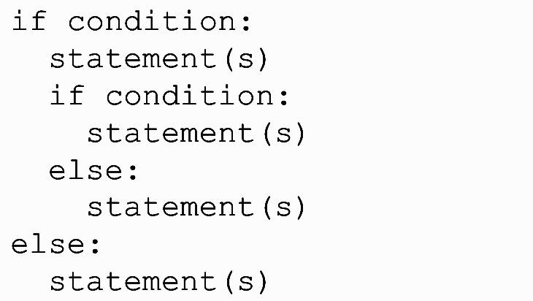
Nested If-else statement
The syntax of the if-statement is

Slide 17
Nested If-else statement
Note that the ‘if’ statements are within the body of another if statement
The statements in this manner are called ‘nested if- statements’
If the first ‘if’ condition is satisfied then the program executes the commands within that ‘if’

Slide 18
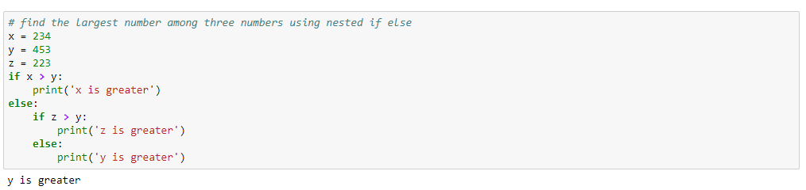
Nested If-else statement

Slide 19
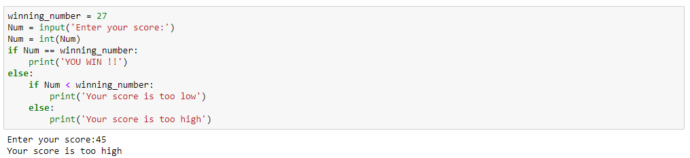
Nested If-else statement

Slide 20
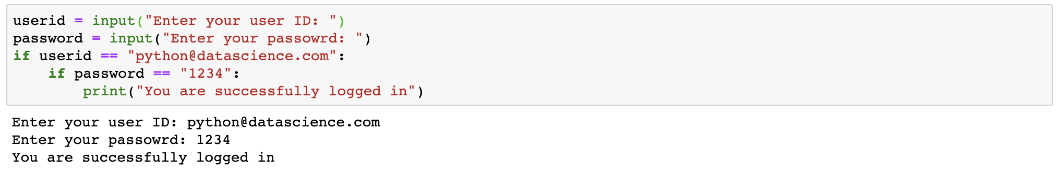
Nested If statement

Slide 21
Loops

Slide 22
Python Iterables
Iterable is a Python object that is capable of returning its elements (or members) one by one
Sequence type Python objects like lists, tupes, dictionaries, strings and sets are iterable type of objects

Slide 23
Iteration through the Iterables
Iteration is a general term for taking each item from a sequence one after another

Slide 24
For Loop

Slide 25
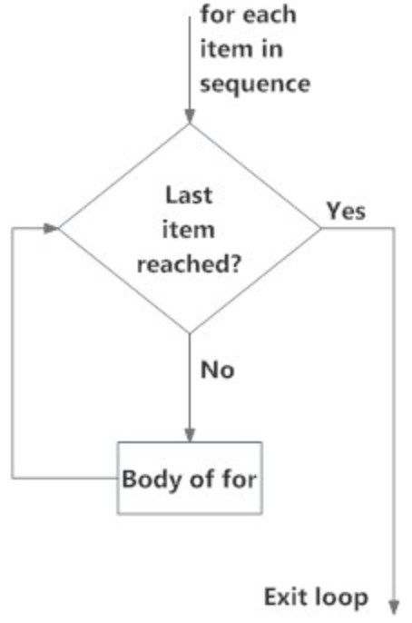
The for loop
The ‘for loop’ is used to iterate over the elements of a sequence (list, dictionary, tuple, string) or other iterable objects.
Iterating over a sequence type object is also known as traversal.

Slide 26
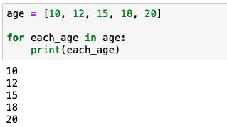
The for loop code example
Enter loop to print each element
A list - sequence type object
Last Element Reached?
A variable to hold a value from the list at each iteration
Yes
No
Print the element
Statement after the loop

Slide 27
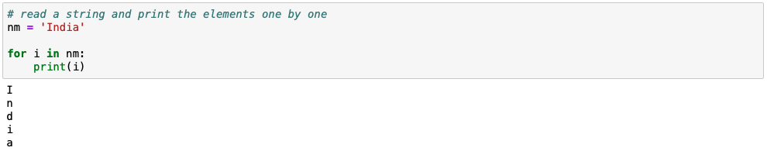
Read each element of a string

Slide 28
While Loop

Slide 29
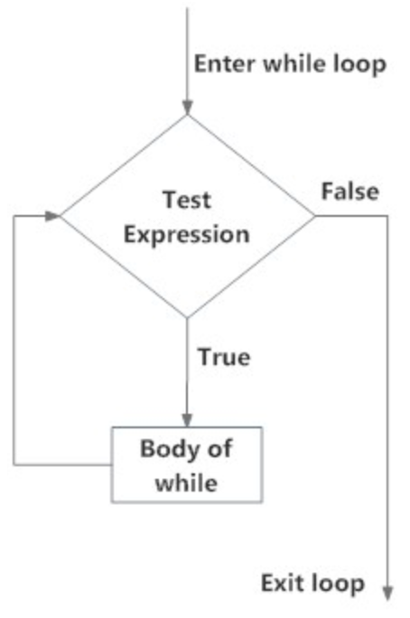
The while loop
The ‘while loop’ in Python is used to iterate over a block of code as long as the test condition is True.
We generally use this loop when the number of times to iterate is not known to us beforehand.

Slide 30
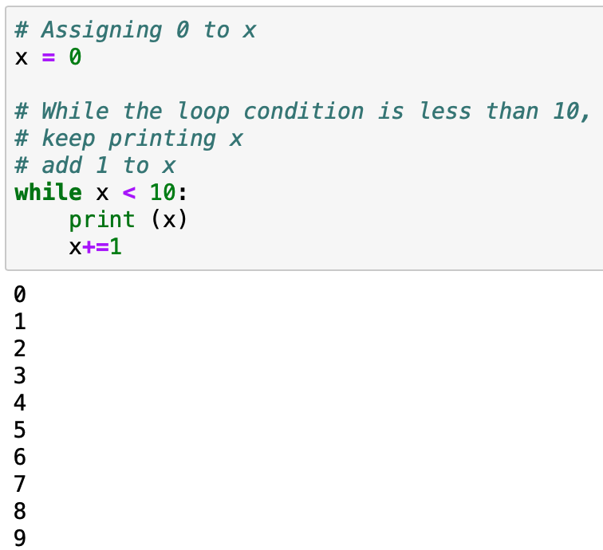
The while loop code example
The while statement checks the condition if x < 10
Enter loop with a pre condition as x < 10
Is the condition met?
N0
Yes
Print the element, increment the value, pass control to while statement
Increment x by 1 and pass the control to the while statement
End loop

Slide 31
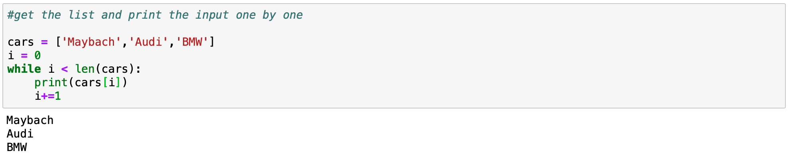
Print each element of a list using while loop

Slide 32
Break, Continue

Slide 33
Exiting a loop
Loops in Python allows us to automate and repeat tasks.
But at times, due to certain factors, we may want to:
Exit a loop completely when a certain condition is met
Skip part of a loop before moving to next

Slide 34
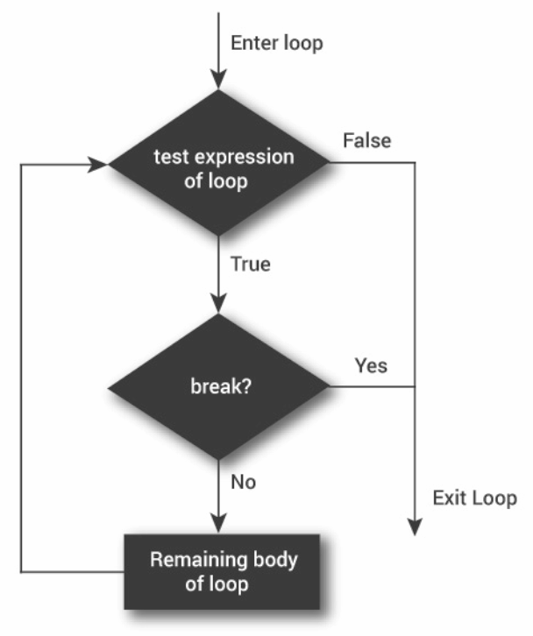
Exit a loop with break statement
The ‘break’ statement ends the current loop and resumes execution at the next statement.
The break statement can be used in both ‘while’ loop and ‘for’ loop.

Slide 35
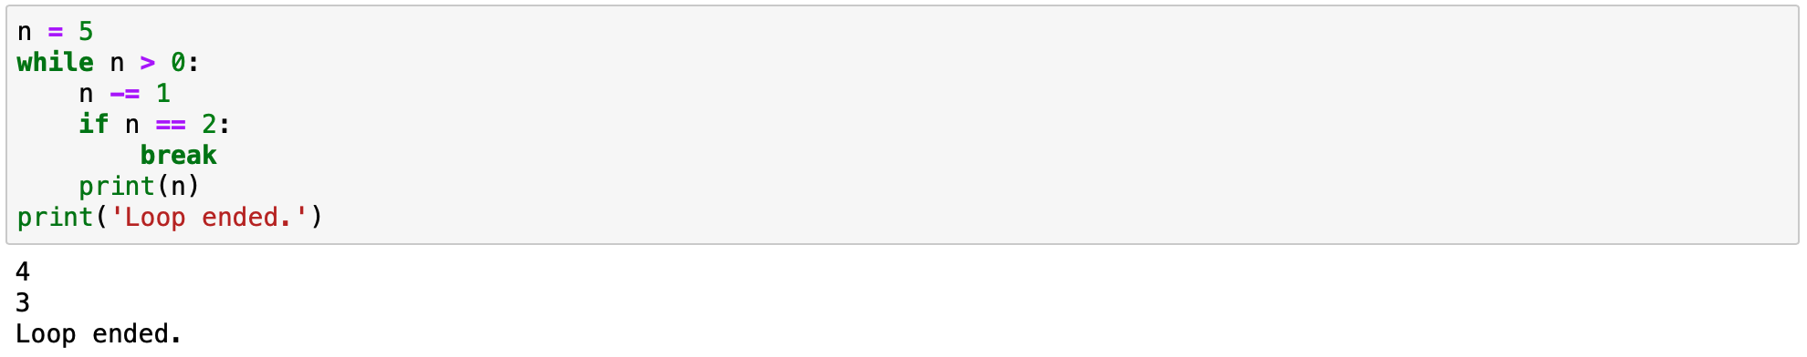
Exit a while loop with break statement

Slide 36
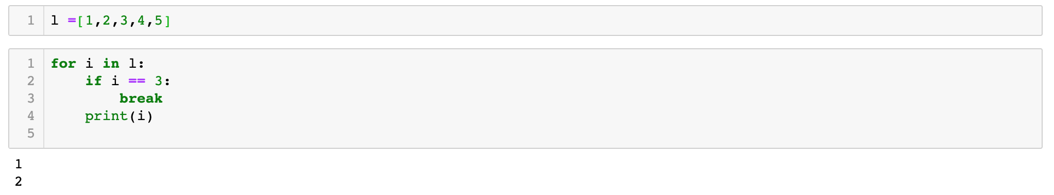
Exit a for loop with break statement

Slide 37
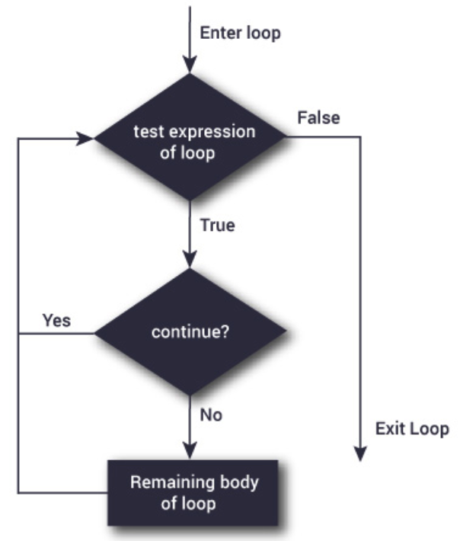
Skip part of the loop with continue statement
The ‘continue’ statement in Python ignores all the remaining statements in the iteration of the current loop and moves the control back to the beginning of the loop.
The continue statement can be used in both ‘while’ loop and the ‘for’ loop.

Slide 38
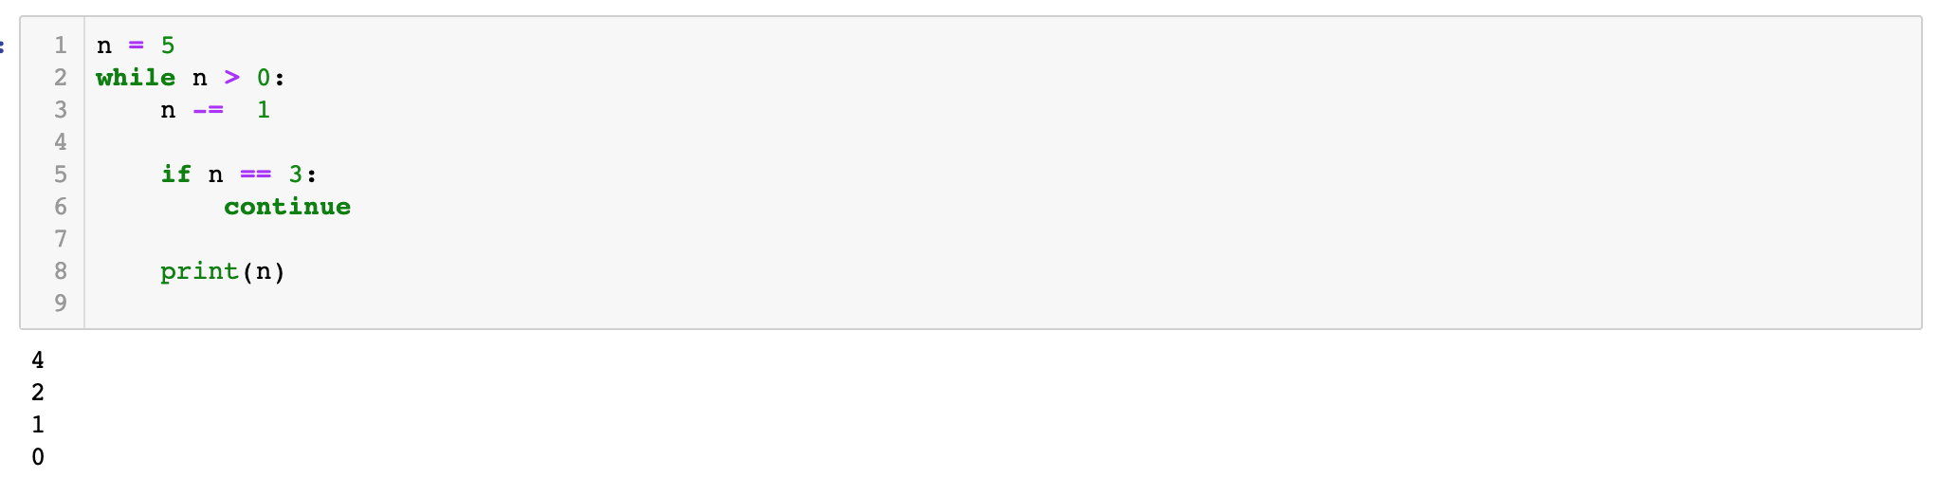
Skip part of the loop with continue statement using while loop

Slide 39
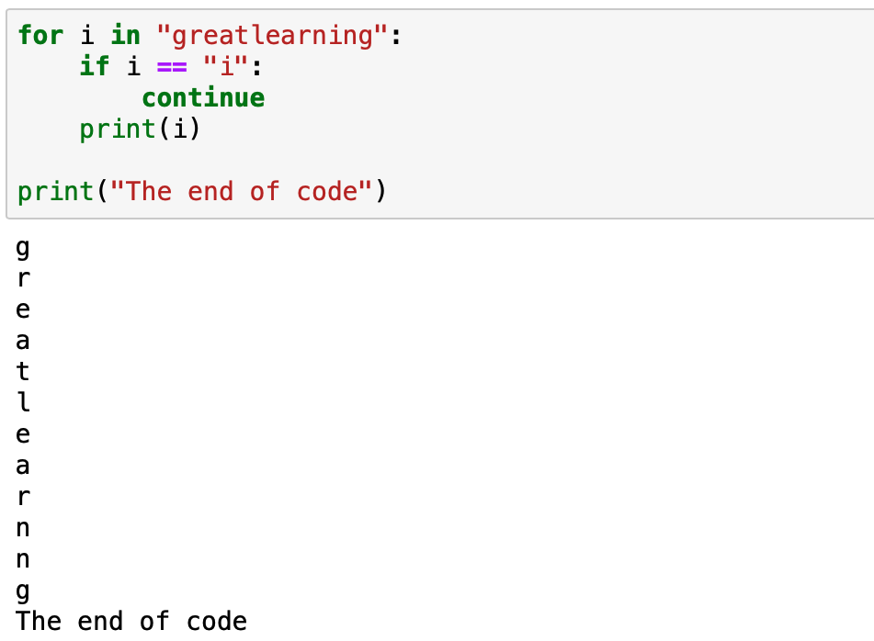
Skip part of the loop with continue statement using for loop
The for...loop iterates through the string character by character
The if condition checks for the condition, x = “i”
The continue statement, when meets the condition, it ignores that character and moves the control to the beginning of the loop

Slide 40
More on Loops

Slide 41
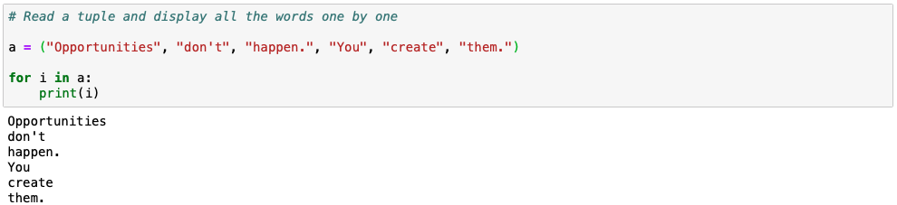
Read each element of a tuple

Slide 42
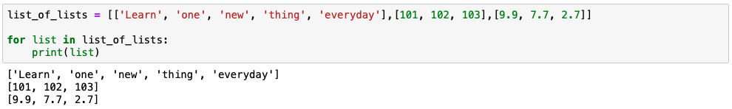
Read through a list of list

Slide 43
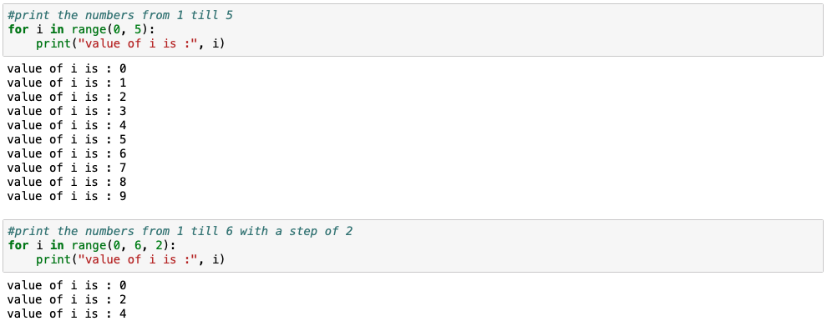
Loop through a range
A range() function takes 3 parameters. Start, stop and step. If step is not provided a default step of 1 is considered.
Here the step is set to 2.

Slide 44
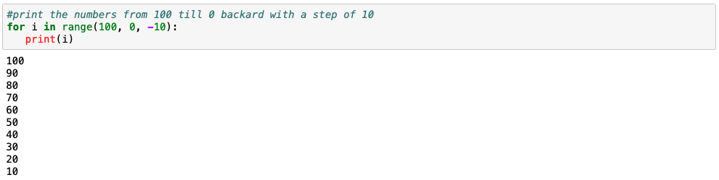
Loop through a range (negative step)
A range() function takes 3 parameters. Start, stop and step. If step is not provided a default step of 1 is considered.
In this example we have a negative step of -10. The range starts from 10. Goes backward to 0 by step 10

Slide 45
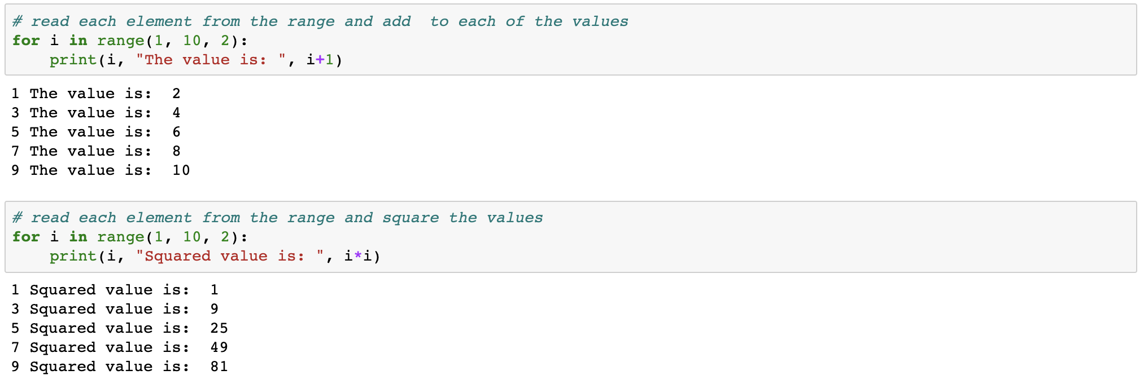
Computation using for…loop

Slide 46
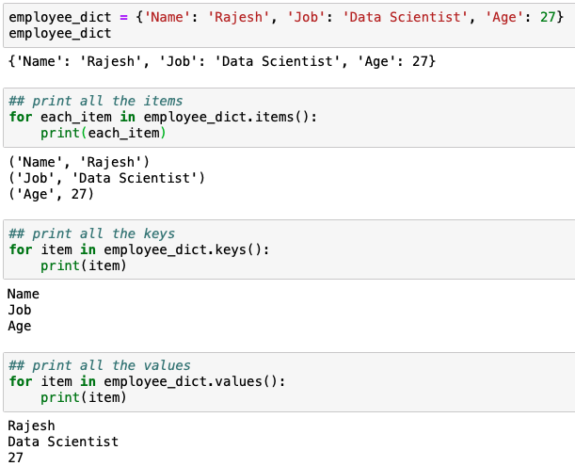
Read through a dictionary object
The dict.items() returns all key-value pair
The dict.keys() returns all keys
The dict.values() return all values

Slide 47
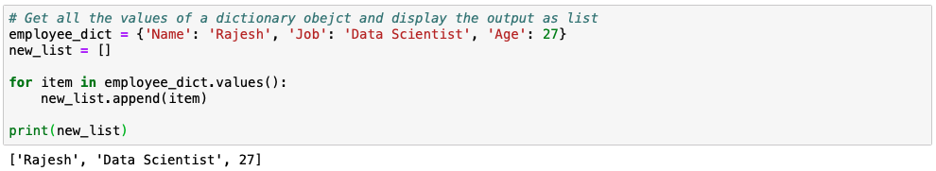
Read through the values in a dictionary to create a list
Create a blank list
Append new value to the list

Slide 48
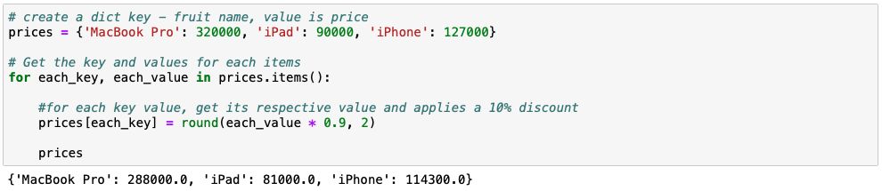
Replace values in a dictionary with computed values
A dictionary object
Applies a 10% discount and returns the price after discount.

Slide 49
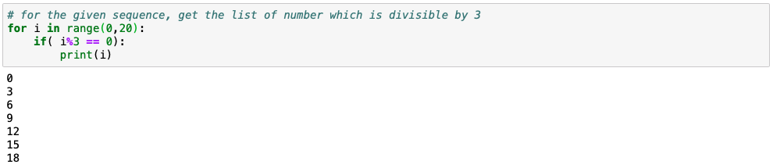
The for loop with conditional statements
For loop
Conditional statement to check if the remainder of a number divided by 3 is zero

Slide 50
Nested for loop
1st level loop or outer loop
for [first iterating variable] in [outer loop]:
[code line 1]
[code line 2]
for [second iterating variable] in [nested loop]:
[code line 1]
1st indentation
Nested loop
2nd indentation

Slide 51
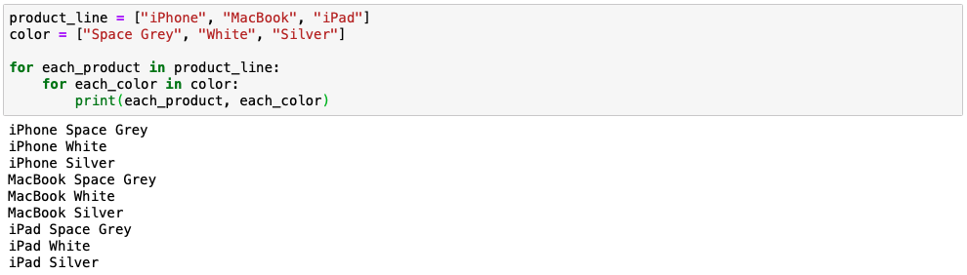
Nested for loop
Outer loop
Inner loop

Slide 52
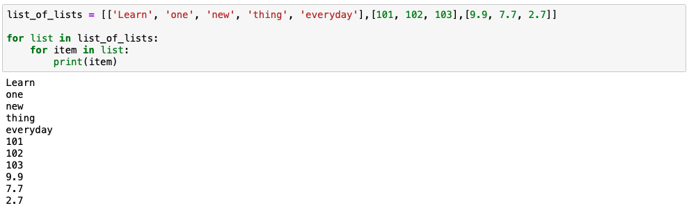
Nested for loop with list of lists
Outer loop
Inner loop

Slide 53
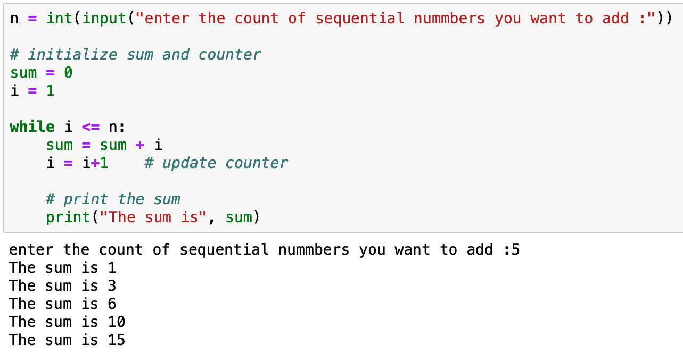
Example: Calculating sum of numbers
Take the input from the user
Using the while loop update the sum and counter
Print the the output for each iteration

Slide 54
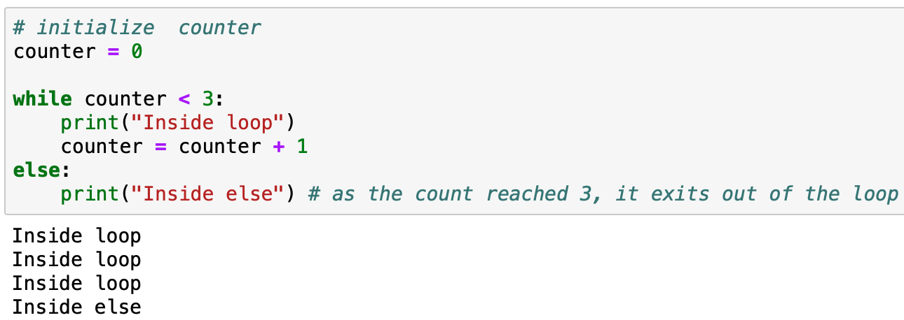
While loop with else statement
The else part is executed if the condition in the while loop evaluates to False
Initialize the counter
Using the while loop update the counter

Slide 55
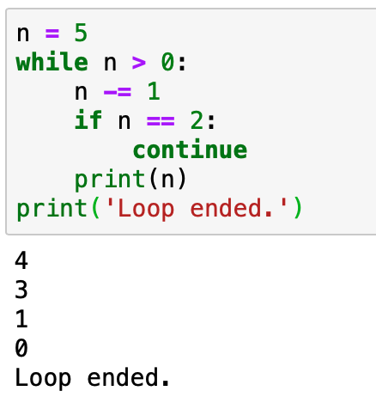
Exit a while loop with continue statement
n ranges from 5 to 1. It reduces by unity in each iteration
The print() is executed if the condition is true

Slide 56
List Comprehension

Slide 57
What is a list comprehension?
A list comprehension provides a concise way to create another list
Using list comprehensions reduces the number of code lines making it. It look more elegant
It is possible to use conditions in a list comprehension
The list comprehension always returns a list

Slide 58
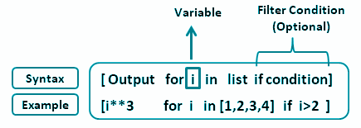
What is a list comprehension?
It consists of [ ] containing:
an input sequence
a variable representing numbers of the input sequence
a conditional expression (optional)
an output expression producing a list
output expression
input sequence

Slide 59
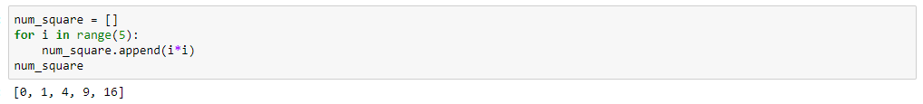
List comprehension vs loops
Create an empty list and append values one by one using for loop
Create a list using list comprehension

Slide 60
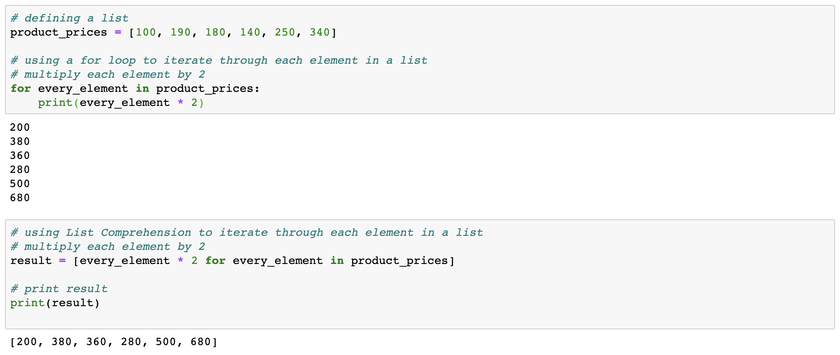
For loop using list comprehension

Slide 61
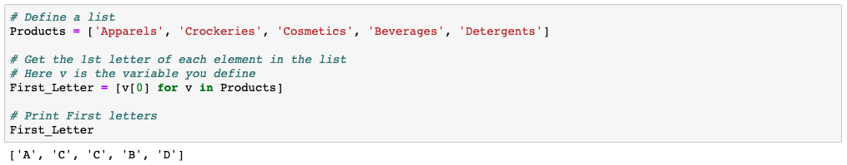
Read the first letter of each word using list comprehension

Slide 62
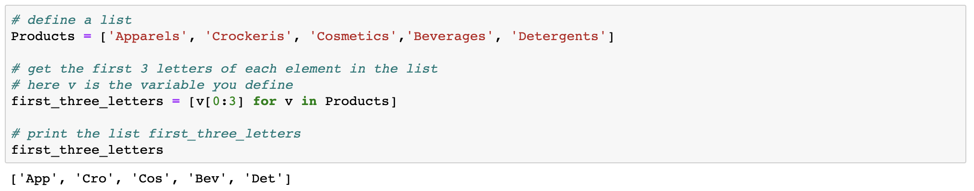
Read the first three letter of each word using list comprehension

Slide 63
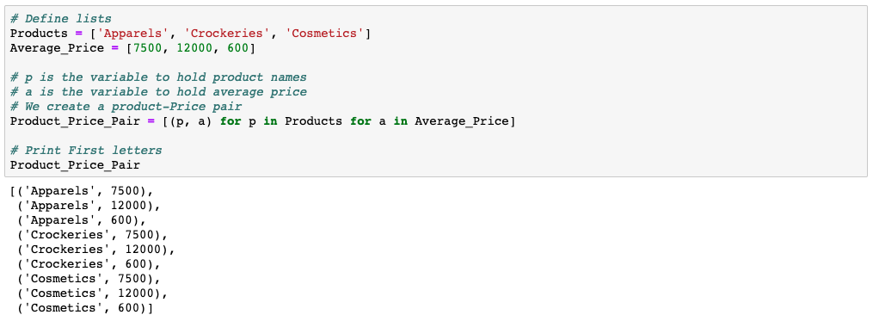
Iteration over more than one iterable in a list using list comprehension

Slide 64
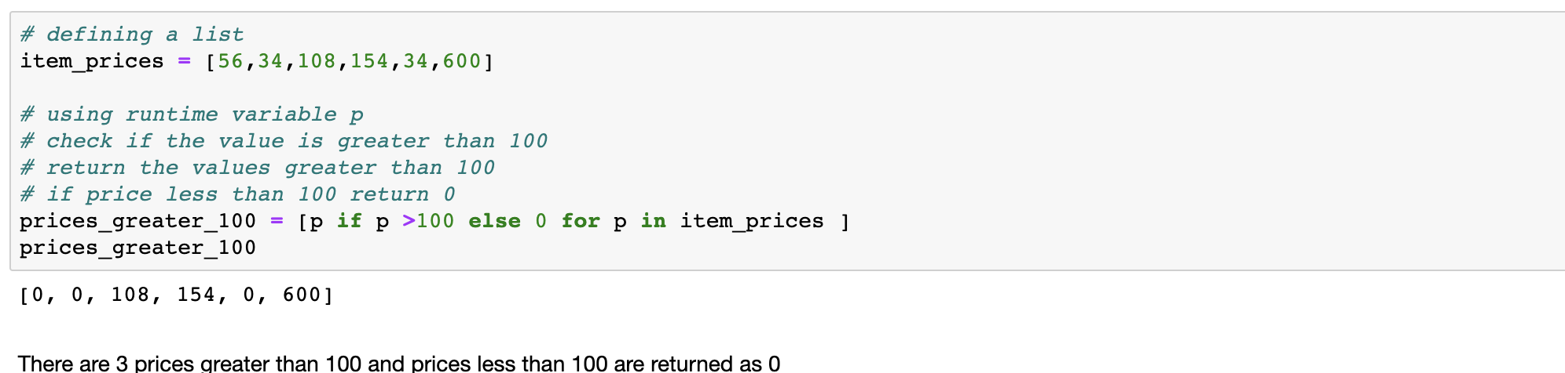
List comprehension using conditional logic

Slide 65
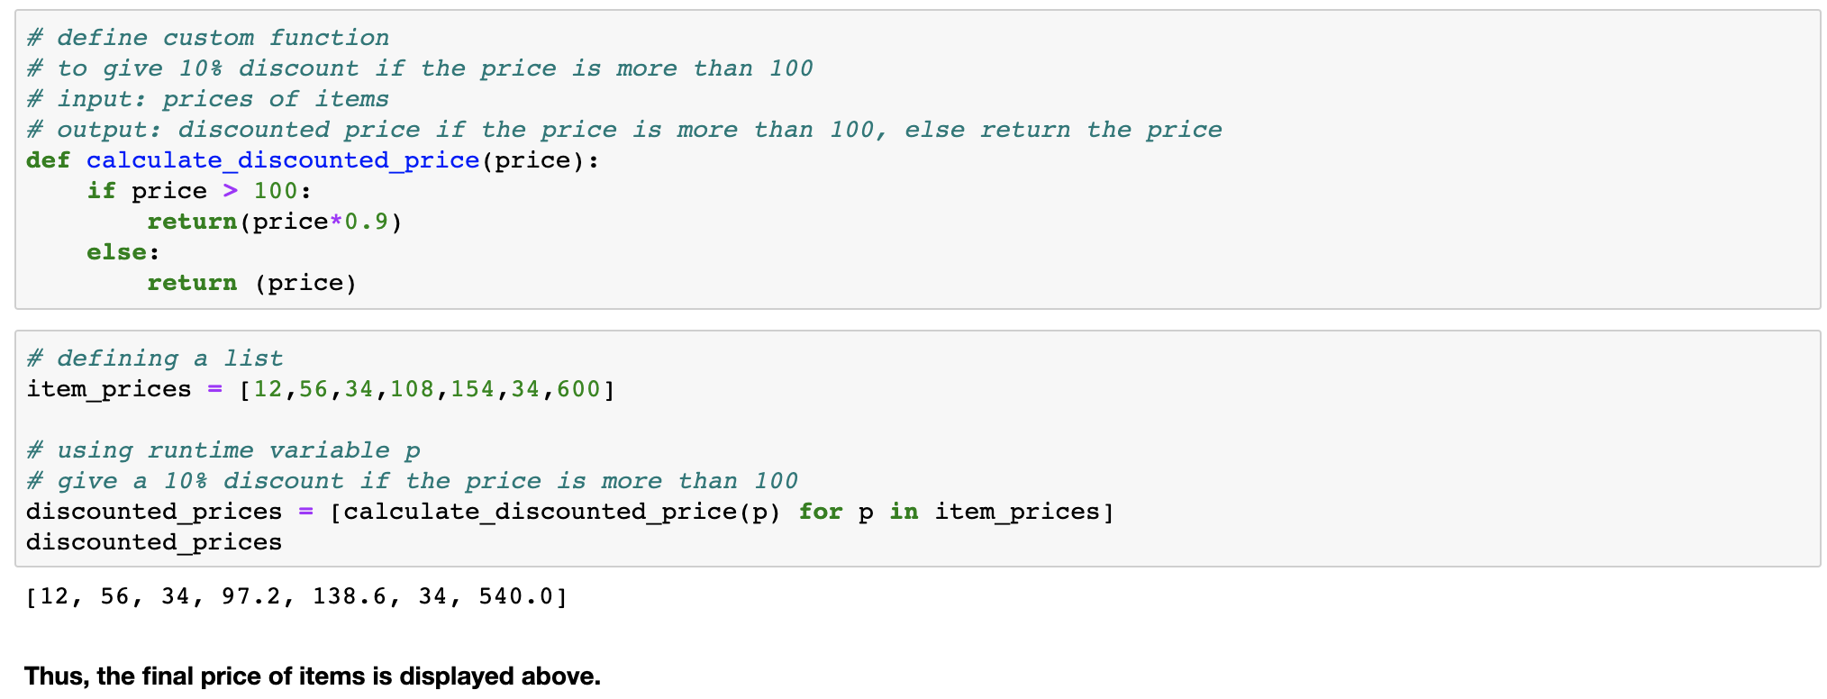
List comprehension using conditional logic with custom function

Slide 66
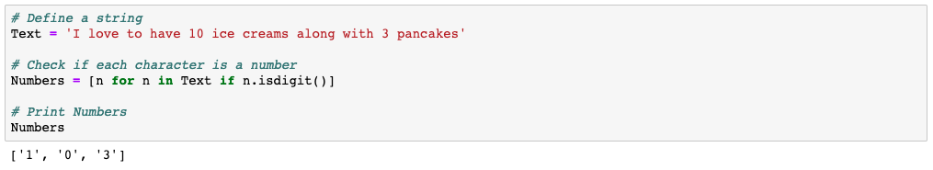
Extract all the digits from the string using list comprehension

Slide 67
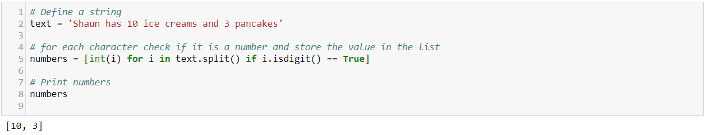
Extract all the numbers from the string using list comprehension

Slide 68
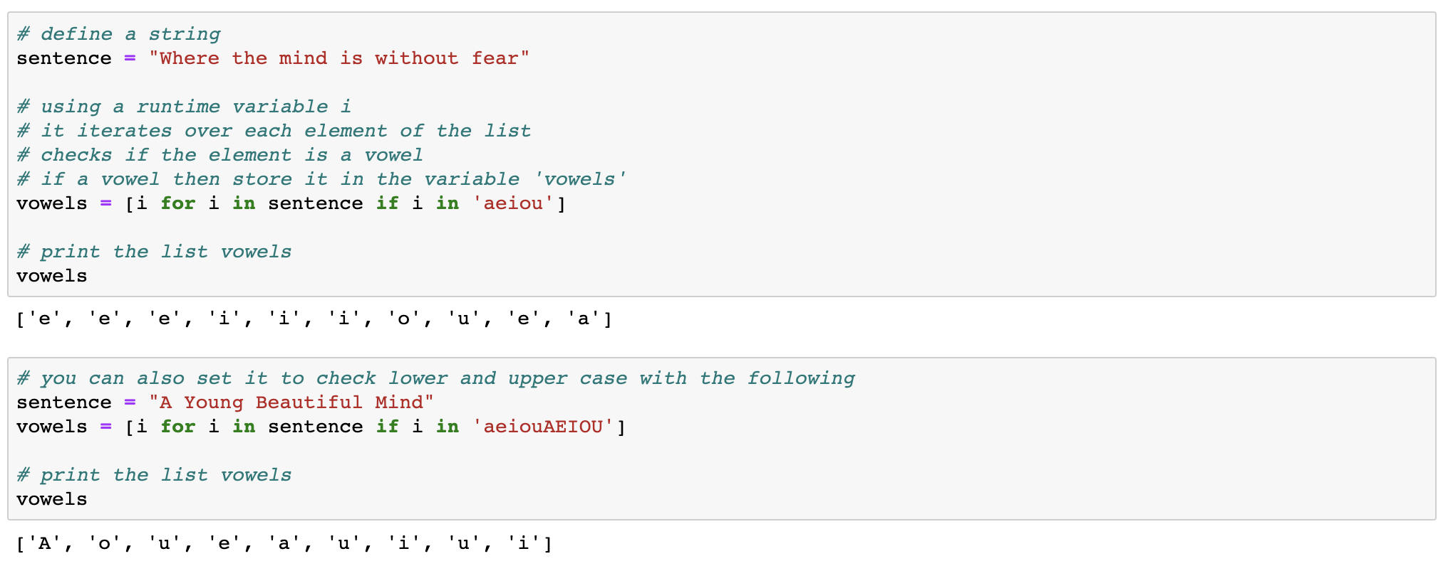
Extract all the vowels from the string using list comprehension

Slide 69
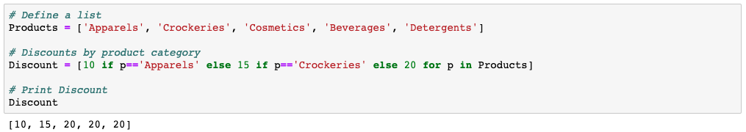
Nested condition within a list comprehension

Slide 70

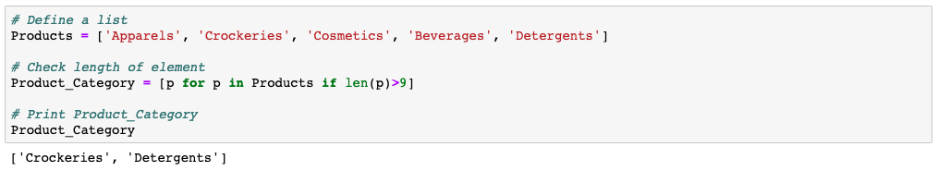
Find strings in a list that are longer than 9 character using list comprehension

Slide 71

A list comprehension helps reduce three lines of code into a single line of code.
Python allocates the list’s memory before appending the elements to the list. This helps avoid resize of the memory at runtime. This makes a list comprehension faster.

Slide 72
Thank You

